Slide 1
Index
1
2
Title
Project Overview
How it Works ?
Demo
Conclusion
Flow Chart
3
4
5
6

Slide 2
TITLE
Title: Android Logger using HTML, CSS, JavaScript and Dropbox.
Objective: To track the opening and closing times of any app on an Android device using a simple logger.
Tools Used: HTML, CSS, JavaScript, Dropbox API.
Android Logger

Slide 3
How it Works ?
A step-by-step guide to using the Android Logger
Install the Android Logger app to your Android device.
Open the app and select the apps you want to log.
The app will automatically start logging when you open or close the selected apps.
The logs are stored in a file on your device and synced to Dropbox for easy access.

Slide 4
Project Overview
What is a Android Logger and how does it work ?
The Android Logger is a simple app that logs the opening and closing times of any app on an Android device.
The app is built using HTML, CSS and JavaScript.
The logs are stored in a file and synced to Dropbox for easy access.

Slide 5
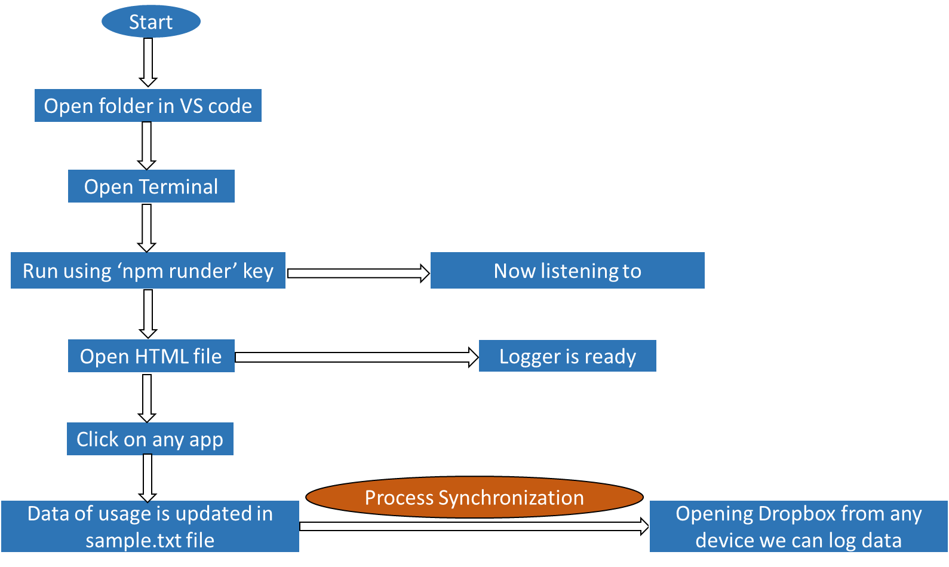
Flow Chart

Slide 6
Conclusion
Wrap-up and key takeaways
The Android Logger is a simple and effective way to keep track of app opening and closing times on an android device.
The app is built using HTML and CSS in JavaScript, making it easy to modify and customize.
The logs are stored in a file and synced to Dropbox, providing easy access and collaboration.

Slide 7
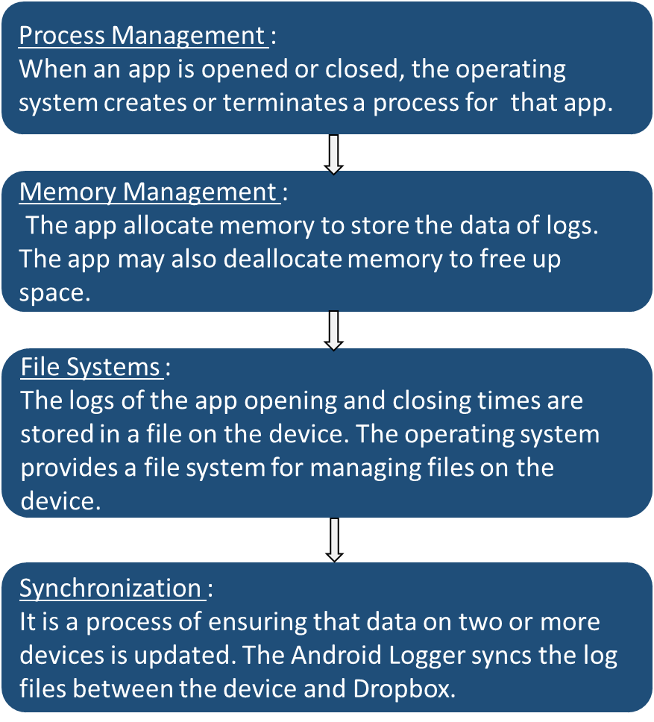
Dropbox Concepts Used

